Slide 1
ROS-Industrial Basic Developer’s Training Class
May 2014
Ian R. Meinzen
Senior Research Engineer
Southwest Research Institute

Slide 2
ROS-Industrial Basic Developer’s Training Class
May 2014
Dan Solomon
Research Engineer
Southwest Research Institute

Slide 3
Outline
What is Linux?
Navigating the Ubuntu GUI
Using the Terminal
Installing ROS
Building a ROS Node
Using ROS Parameters
Using ROS Messages and Topics

Slide 4
Outline - Abridged
What is ROS?
What is Catkin?
ROS Parameters
Eclipse
ROS Messages
ROS Services
Using Launch Files

Slide 5
An Introduction to Linux
An operating system (think Windows/MacOS X)
Used on everything from Android phones to web servers
Open source – you can add software to/remove software from, modify internal workings, etc., to core components as needed
Actually a loose collection of software collected together – There are multiple “distributions” of Linux
We will be using Ubuntu for this course

Slide 6
A Lightning Primer to the Ubuntu GUI

Slide 7
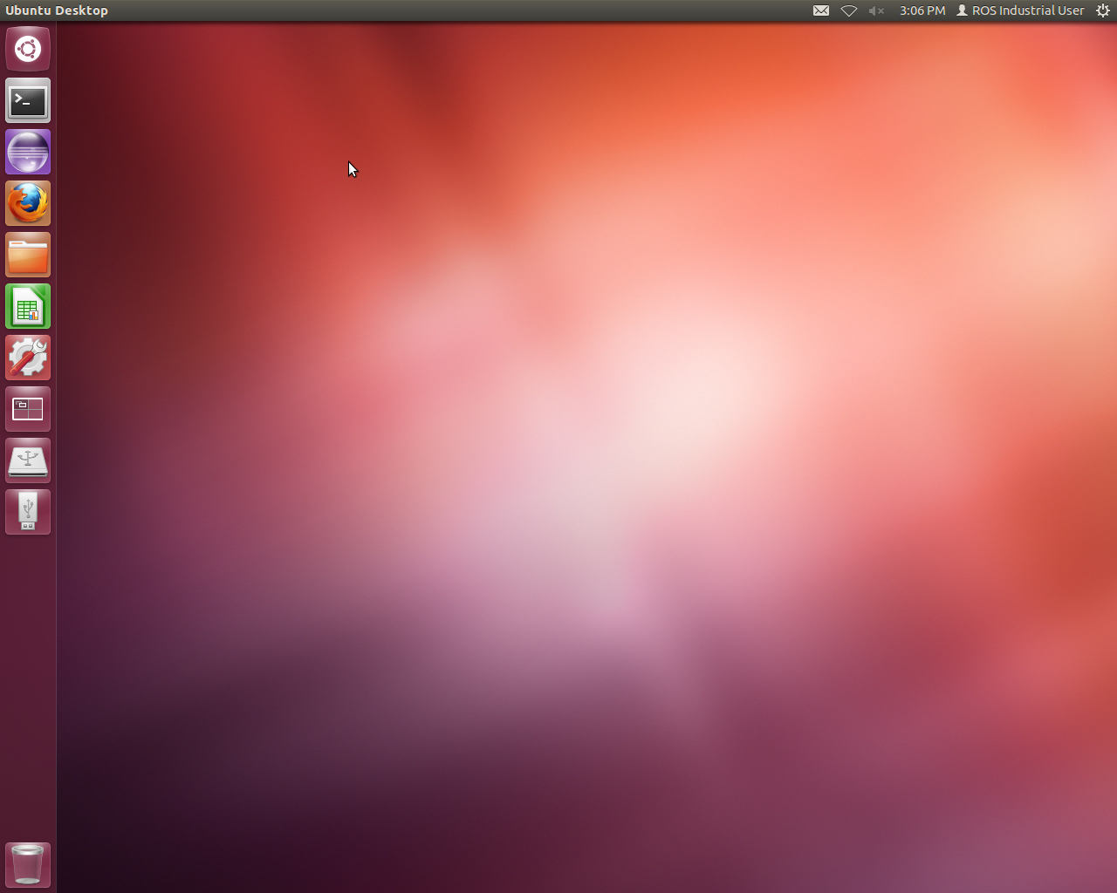
The Ubuntu GUI

Slide 8
Where Is Everything?
Ubuntu icon at top left is “Start button”
Applications show up below, can be “pinned” to launcher (some are already)
2x2 grid is workspace launcher; any thumb drives, CDs, etc. are shown below icon
Top right hand corner is “system tray”/notification area
The gear icon at top right can be used to shut down or log off computer.

Slide 9
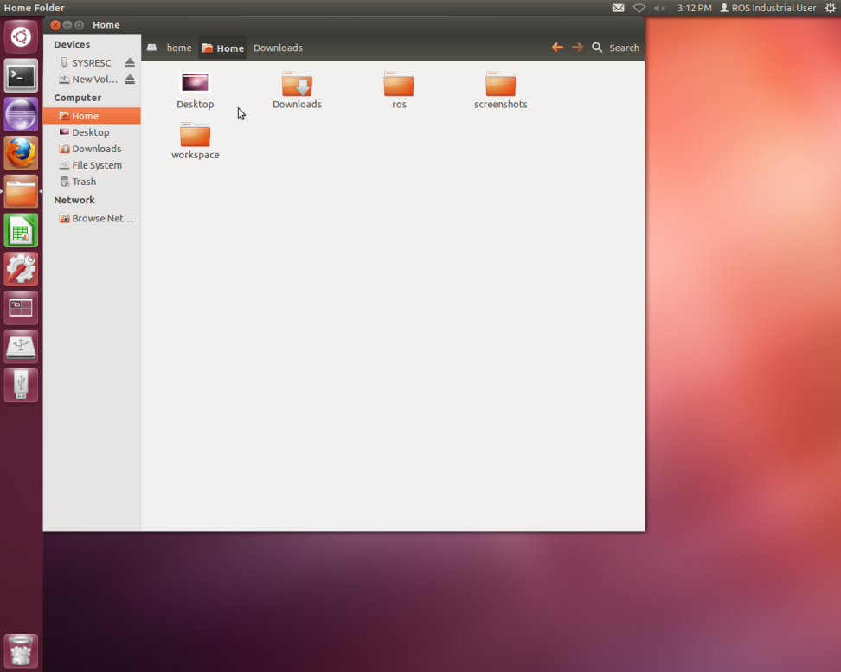
Ubuntu Windows
Close, minimize, and maximize buttons are at top left of window, not top right
Menu bar is at top of screen, not window (like Macs)
Must hover mouse over top window to view

Slide 10
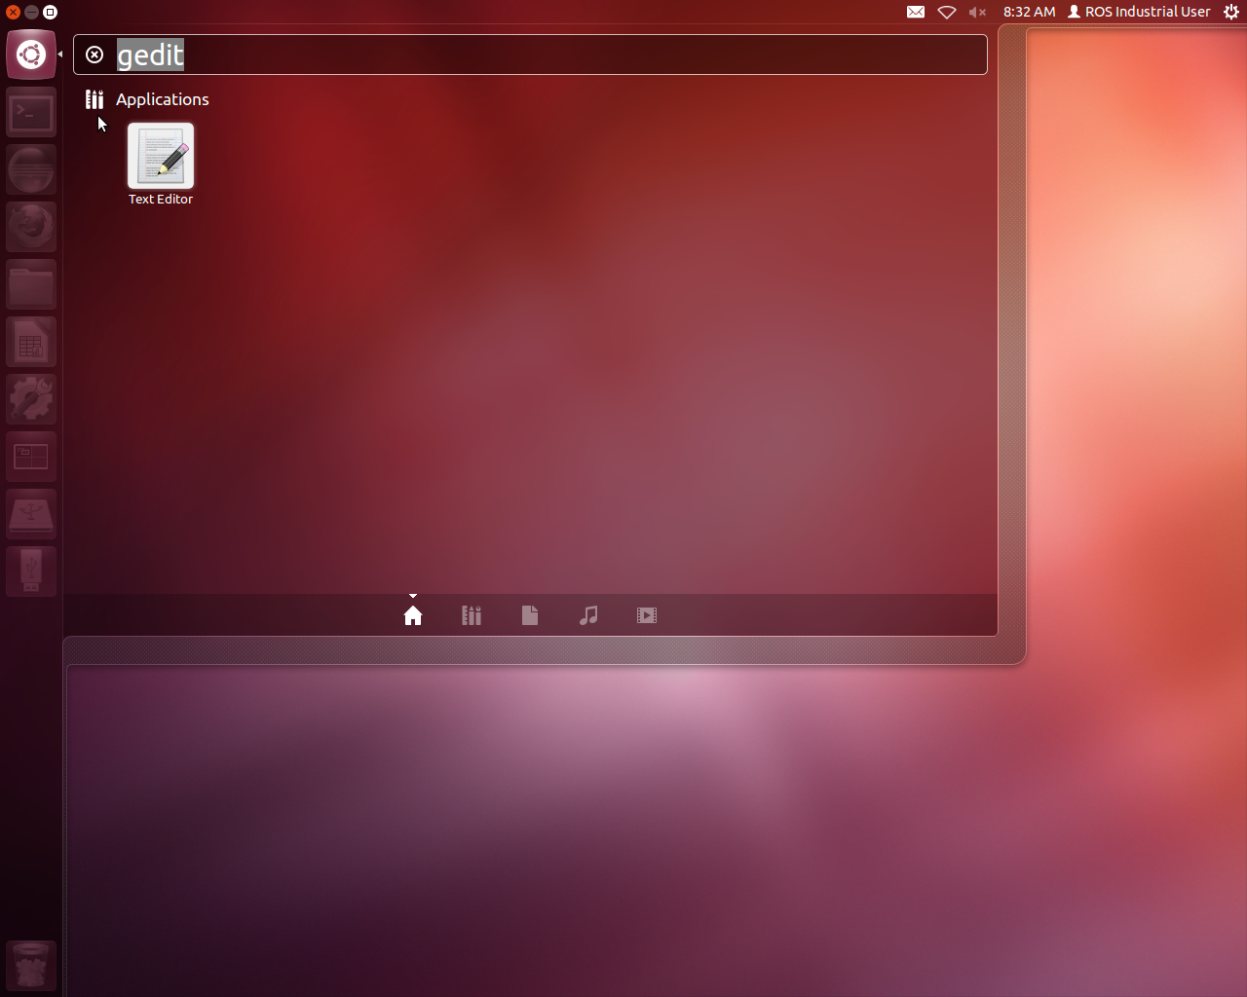
Starting Applications
Click on the Ubuntu icon and start typing
Searches application filenames, titles, descriptions, etc., for your input
When the application shows up, click on it to start
Also searches files, etc. for search terms

Slide 11
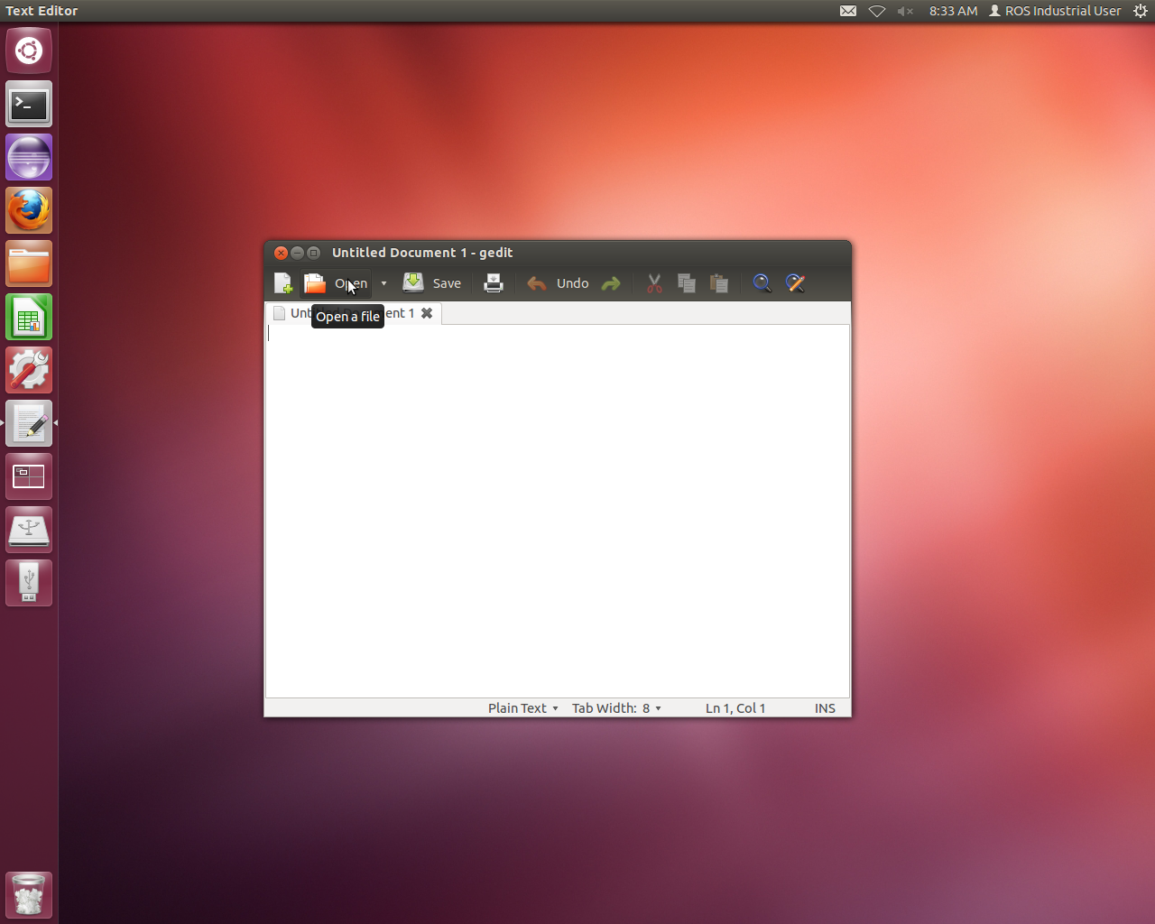
Launcher Bar
Little triangles on the left side of the icon shows that there are windows of that application open
Triangle on the right hand side shows which window has focus
To pin launcher, right-click on icon and select “Add to launcher”

Slide 12
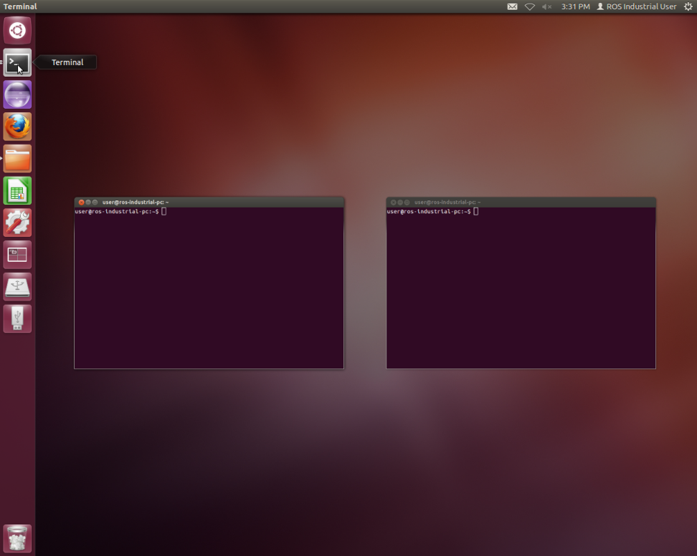
Bringing Windows to Foreground
If you have multiple windows of the same type open, multiple triangles show up on left hand side
Single Window: Clicking on icon will bring window to foreground
If you click on an icon with multiple windows open, all of the possible windows are brought to the foreground.

Slide 13
The Linux File System
Hierarchical file system, similar to Windows/Mac
Major differences from Windows:
Linux uses ‘/’ character for separating directories, not ‘\’
No concept of “C: Drive” – the primary hard drive is mounted as the root (/) folder, and all CD-ROMs, network drives, etc. are mounted as subfolders of the root, e.g. /media/THUMBDRIVE
Linux file system can contain more than files (disk drives, serial ports, etc.)

Slide 14
The Linux File System (cont’d).
Users ordinarily only have full access to their home directory (/home/<username>)
Files don’t have hidden attribute, like Windows. Instead, all files which begin with a “.” are “hidden”

Slide 15
Using the Linux Terminal

Slide 16
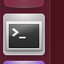
Using the Linux Terminal
Similar to Windows command prompt, but “on steroids”
Essential for developing ROS applications
Click on the terminal icon to open a terminal
Open new terminal window
Menu→File→Open Terminal
Ctrl+Shift+N
Terminals can have multiple tabs
Menu→File→Open Tab
Ctrl+Shift+T
You can use “*” and “?” characters as wildcards when specifying names

Slide 17
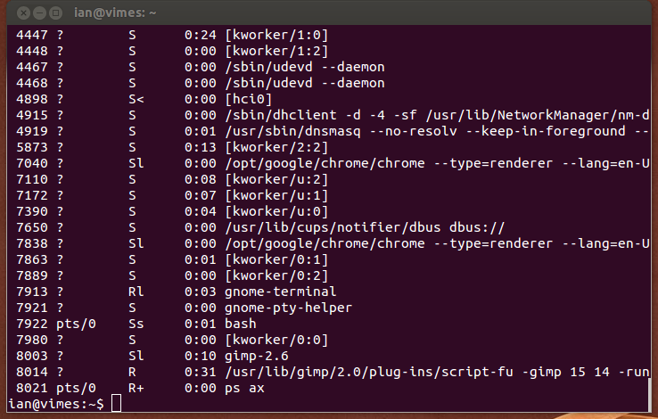
Running Commands in Linux
Terminal opens with prompt
Type command, followed by enter
Command will run, then return with prompt
If command needs to be “killed”, press Control and C simultaneously (often abbreviated “Ctrl+C”)
Hovering on right hand side will show you the scroll bar
The tab key is your friend!

Slide 18
Standard Commands for Linux
ls – Lists files and folders. Specifying a file or wild card will show only the files listed
ls –a – Lists hidden files as well.
cd <folder> - Changes the working folder to the given folder
pwd – Prints the current working folder
cp <src> <dest> - Copies <src> to <dest>
mv <src> <dest> - Moves/renames <src> to <dest>
rm <file> - Removes <file>
ps ax – Shows all processes running on computer
kill <pid> - Kills program with process <pid>

Slide 19

An Introduction to ROS
(Image taken from Willow Garage’s “What is ROS?” presentation)

Slide 20

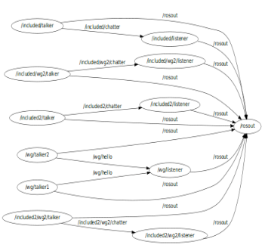

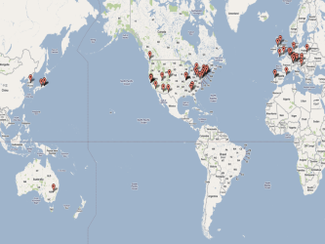
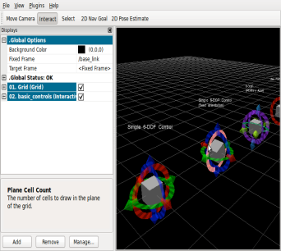
What is ROS?
ROS is…
(Adapted from Willow Garage’s “What is ROS?” Presentation)
=
+
+
+
Plumbing
Tools
Capabilities
Ecosystem

Slide 21
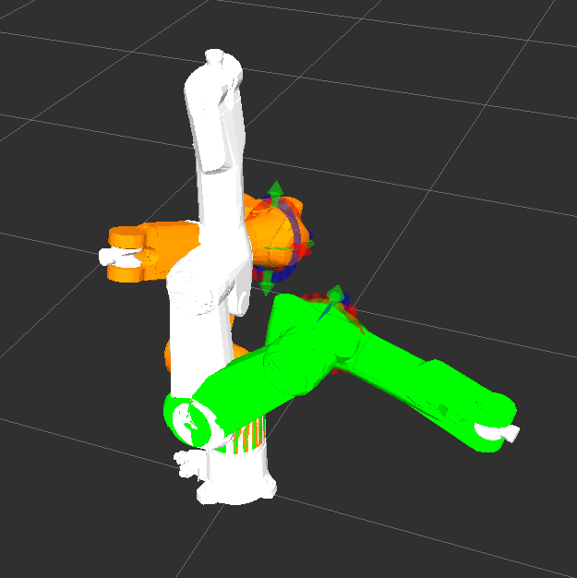

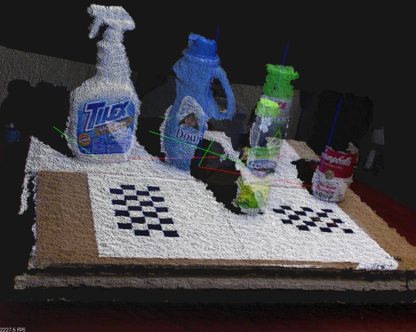

ROS is…Capabilities
Planning
Perception
Execution
(Adapted from Willow Garage’s “What is ROS?” Presentation)
(Adapted from Willow Garage’s “What is ROS?” Presentation)

Slide 22
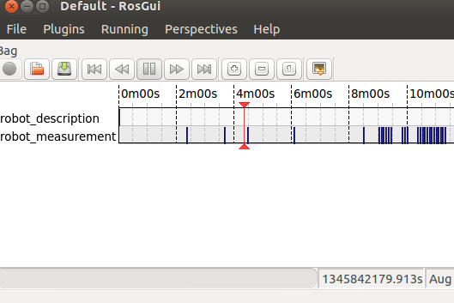
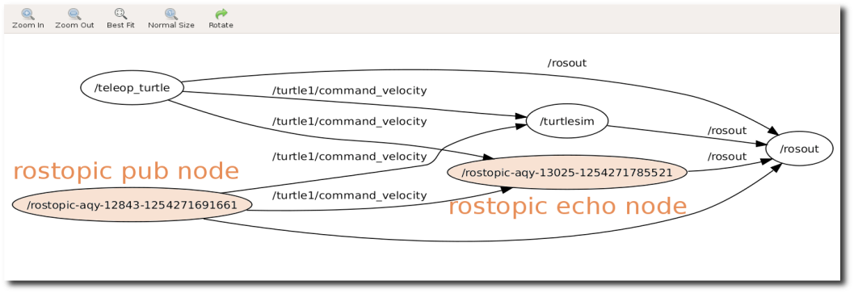
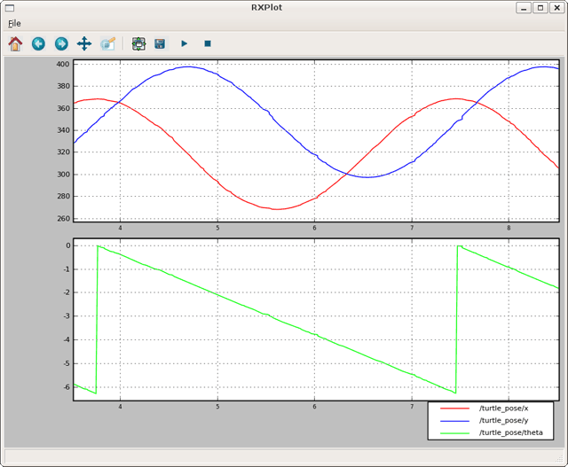
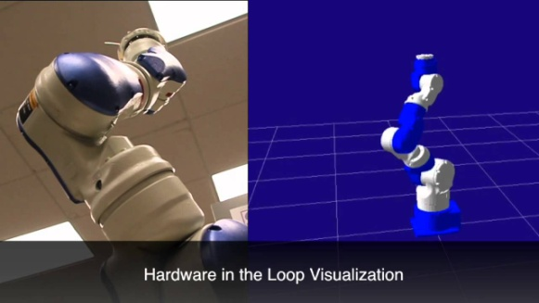
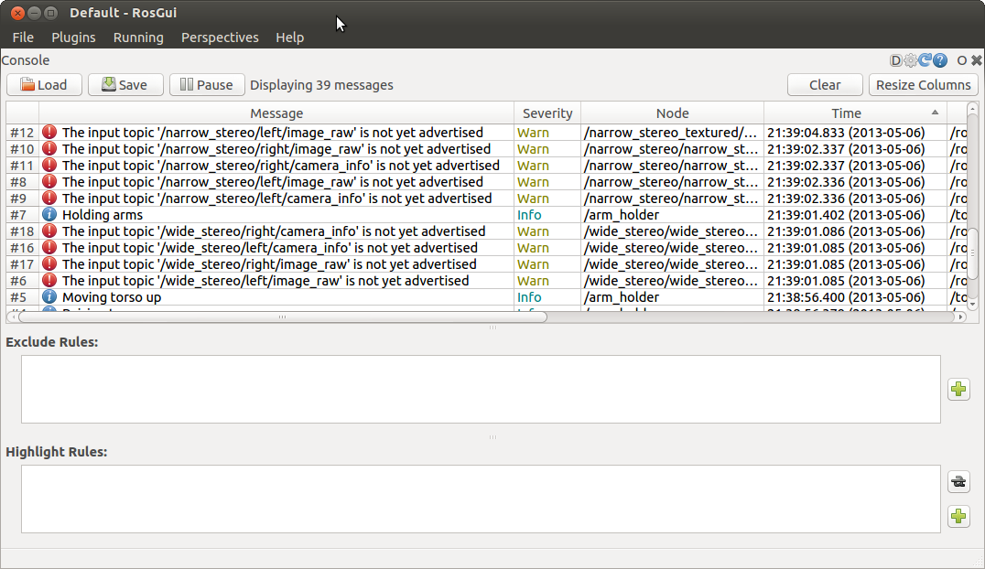
ROS is …Tools
logging/plotting
graph visualization
diagnostics
visualization
(Adapted from Willow Garage’s “What is ROS?” Presentation)

Slide 23
ROS is… plumbing
Master
(Adapted from Willow Garage’s “What is ROS?” Presentation)
register(/topic)
query(/topic)
(DNS-like)
Publisher
Subscriber
/topic
Publisher
Subscriber

Slide 24
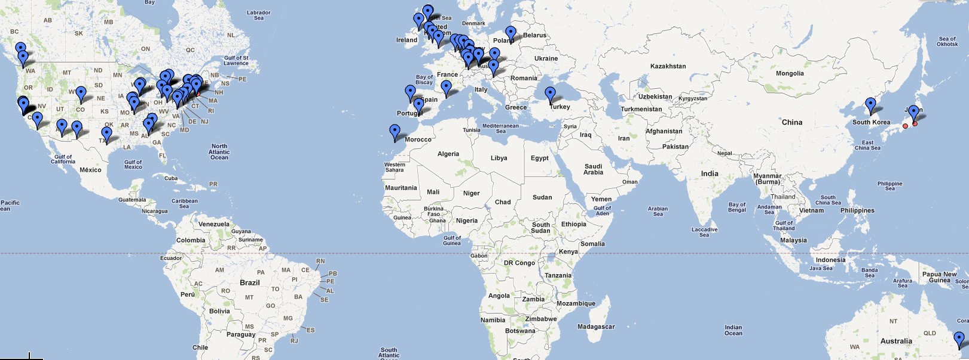
ROS is… an Ecosystem
(Adapted from Willow Garage’s “What is ROS?” Presentation)

Slide 25
ROS Programming
ROS framework uses platform-agnostic methods (TCP/IP sockets, XML, etc.) for inter-process communication
Client implementations are possible in many different languages, currently implemented in C++, Python & Lisp
We will be using C++ for our exercises

Slide 26
Installing ROS

Slide 27
Configure apt Repository
In Ubuntu, applications are usually installed through the “apt” system
Apt repositories provide package files which contain libraries and applications
Provides single location to search for/install applications/libraries/packages
Installs dependent libraries & applications automatically
Updates applications automatically
Third-party app developers can add their own repositories to the apt system
ROS installation link: http://www.ros.org/wiki/hydro/Installation/Ubuntu

Slide 28
Installing Software using apt
sudo apt-get install <package-name>
Downloads packages from repository, copies files to appropriate locations, and runs setup scripts
Any other packages which are needed are installed as well
ROS packages are named ros-<version>-<package_name>, where
<version> is the code name of the version (in this case, hydro
<package_name> is the name of the package. Note that ‘_’ characters need to be changed to ‘-’
For instance, the sensor_msgs package for groovy is named ros-groovy-sensor-msgs
Software can be removed by sudo apt-get remove <package_name>

Slide 29
Searching For Packages
ROS wiki (http://www.ros.org/wiki)
Browse for packages in ROS repository
apt-cache search <search term>
Searches titles and descriptions for search term
aptitude
Menu-based interface to apt, can be used to search as well

Slide 30
ROS Core programs
Three core ROS programs need to be running
ROS Master Server: Manages topic subscriptions
ROS Parameter Server: Manages ROS parameters
rosout: Node responsible for logging messages from all other ROS nodes
All programs are started by running the roscore program
Will also start automatically when using roslaunch

Slide 31
Creating a ROS Node

Slide 32
ROS Packages
ROS programs, libraries, etc. are organized into packages
With the catkin build system, catkin-create-pkg is used to create a package folder.
Usage: catkin-create-pkg package_name dependency1 depenency2 …
package_name is name of package to be created
dependency1/2/etc., are packages which this package depends on. Can be specified later, if need be.
Packages contain several files
package.xml: Contains package title, description, dependencies, etc.
CMakeLists.txt: Contains rules for building applications, libraries, etc.

Slide 33
CMakeLists.txt
Provides rules for building software
File contains many example rules for nodes, libraries
add_executable(sample_node sample_node.cpp)- Creates node sample_node, built from sample_node.cpp)
add_message_files(…) and generate_messages(…)- Generate messages from definition files

Slide 34
package.xml
Contains description of package, author, etc.
For building nodes, critical elements are depend tags
<build_depend>package</build_depend>
Usually generated by catkin-create-pkg
Can be added to file manually later.
Used by catkin_make to ensure all dependent software exists and is up to date before building the requested package

Slide 35
What is Catkin?
Build system used by ROS
Makes heavy use of CMAKE
Cross platform
Better support
Replaces ROSBUILD

Slide 36
catkin_make
To build software with catkin, simply type catkin_make in the catkin workspace directory
All dependent packages will be checked to make sure they are up to date, then system will build libraries and executables in CMakeLists.txt

Slide 37
A Simple C++ ROS Node
Simple C++ Program
int main(int argc,
char* argv[])
{
return 0;
}
Simple C++ ROS Node
#include <ros/ros.h>
int main(int argc,
char* argv[])
{
ros::init(argc, argv, “node”);
ros::NodeHandle node;
ros::spin();
return 0;
}

Slide 38
Running a ROS Node
ROS nodes can be launched using the command rosrun package_name node_name
Must be built before running the node
View running nodes with rosnode list
Kill running nodes with rosnode kill node_name

Slide 39
Eclipse Usage and Hints
Eclipse is an open-source development tool (IDE)
Supports many languages including C/C++, Python, Java
Create project files from catkin workspace
In top level of catkin workspace, run catkin_make --force-cmake -G"Eclipse CDT4 - Unix Makefiles”
In top level of catkin workspace, run cmake -G"Eclipse CDT4 - Unix Makefiles” .
Will create files .project and .cproject in build/(former) or src/(latter) directory
Import project files into Eclipse
File -> Import -> General -> Existing Projects into Workspace
(Next) Browse to directory -> Next

Slide 40
ROS Parameters
ROS parameters are accessed through parameter server.
Support for multiple data types
Hierarchical – can load and save parameters in multiple levels
Hierarchical layout allows for saving and loading nodes parameters on a per-node basis
Nodes can access parameters through API

Slide 41
ROS C++ Parameter API
Accessed through ros::NodeHandle
To access parameters from within a certain namespace, pass the namespace as a string to the NodeHandle constructor
To access parameters from within the node’s “private namespace”, pass “~” as the NodeHandle constructor
Can create multiple NodeHandles to access different namespaces
Namespace Examples
ros::NodeHandle global_node;
getParam(“test”) returns parameter “/test”
ros::NodeHandle ns_node(“/ns”);
getParam(“test”) returns parameter “/ns/test”
ros::NodeHandle
local_node(“~”);
getParam(“test”) returns:
“/node1/test” for node /node1,
“/a_node/test” for ROS node /a_node,
and so on…

Slide 42
ROS C++ Parameter API (cont’d)
NodeHandle methods
hasParam(key) Returns true if parameter exists
getParam(key, &value) If parameter exists, places the parameter into value, and returns true. Returns false if the parameter doesn’t exist
param(key, &value, default) Same as getParam, but sets value to default if the parameter doesn’t exist
setParam(key, value) Sets the parameter to value
deleteParam(key) Deletes the parameter
ros::NodeHandle nh;
int value;
// Get parameter (with default)
nh.param(“value”, value, 0);
// Set parameter in new value
nh.setParam(“new_value”, value);
// Delete original
nh.deleteParam(“value”);

Slide 43
rosparam Command Line Tool
Tool to access parameter server without having to write code
Setting parameters: rosparam set <key> <value>
Getting parameters: rosparam get <key>
Deleting parameters: rosparam delete <key>
List all parameters currently set: rosparam list
Save parameters to file: rosparam dump <filename> [<namespace>]
Load parameters from file: rosparam load <filename> [<namespace>]

Slide 44
Dynamically reconfiguring nodes
ROS package dynamic_reconfigure can be used to run a callback to reset algorithms, data, etc. when a parameter changes
Outside the scope of this class, but useful

Slide 45
ROS Messages and Topics

Slide 46
ROS Topics:
Messages, Services, Actions

Slide 47
Message vs. Service vs. Action
Type | Strengths | Weaknesses
Message | Good for most sensors (streaming data) | Messages can be dropped without knowledge Easy to overload system with too many messages
Service | Knowledge of missed call Well-defined feedback | Blocks until completion Connection typically re-established for each service call (slows activity)
Action | Monitor long-running processes Handshaking (knowledge of missed connection) | Complicated Mixed feedback from multiple action servers (not for SimpleAction)

Slide 48
Messages

Slide 49
ROS Messages
ROS messages are data structures used by ROS topics and services
Similar to C structures
Standard data primitives
Boolean: bool
Integer: int8,int16,int32,int64
Unsigned Integer: uint8,uint16,uint32,uint64
Floating Point: float32, float64
String: string
Fixed length arrays: bool[16]
Variable length arrays: int32[]

Slide 50
Custom ROS Messages
Custom message types are defined in msg subfolder of packages
To create a message definition, create a file named your message type name, with a .msg extension, in the message folder
Modify CMakeLists.txt to enable message generation.
You can also include message types from other packages (see the Header field to the right).
PathPosition.msg
# A 2D position and orientation
Header header # Message header
float64 x # X coordinate
float64 y # Y coordinate
float64 angle # Orientation

Slide 51
Using rosmsg
rosmsg list: Show all ROS topics currently installed on the system
rosmsg package <package>: Show all ROS message types in <package>
rosmsg show <package>/<message_type>: Show the structure of the given message type

Slide 52
ROS Topics
ROS Topics are a method of communicating data between nodes
Topics use ROS message definitions for data types
Anonymous subscribe/publish transport type
Any number of nodes can publish to a topic
Any number of nodes can subscribe to a topic

Slide 53
Using ROS Topics in C++
Include message type header file in source code (#include <package_name/message_type.h>)
Publishing
NodeHandle::advertise<type>(topic_name, queue_size): Inform ROS that this node will be publishing a topic named “topic_name” of type “type”. The “queue_size” parameter is the size of the queue for sending messages
The advertise method creates a Publisher object.
To publish, create a message object, and pass it to the Publisher’s publish method
Sample Publisher Node
#include <package/PathPosition.h>
…
// Create a publisher
ros::Publisher pub = nh.advertise<PathPosition>(
“/position”, 25);
…
// Fill a message and send it on
// the publisher
PathPosition msg;
msg.x = x_coord;
msg.y = y_coord;
msg.angle = angle;
pub.publish(msg);
// Spin at least once to publish
// message
ros::spinOnce();

Slide 54
Using ROS Topics in C++ (cont’d)
Subscribing
Create a method with the signature void(const message_type& message);
Call NodeHandle’s method subscribe. The method signature is ros::Subscriber subscribe(const std::string& topic, uint32_t queue_size, callback). The method will connect callback to the topic, with a maximum queue size of queue_size.
Callbacks can take a variety of forms, including methods of a class.
While the node is running, whenever the topic receives data, the callback will be run.
Sample Subscriber Node
#include <package/PathPosition.h>
// Write a method/function to be called when new messages arrive
void msg_callback(const PathPosition& msg)
{
…
}
…
// Create a subscriber to attach
//msg_callback to topic
ros::Subscriber sub = nh.subscribe(“/topic”, 25, msg_callback);
…
// When spin/spinOnce is called,
// msg_callback will be called
// for received messages
ros::spin();

Slide 55
Using rostopic
rostopic list: List all topics currently subscribed to and/or publishing
rostopic type <topic>: Show the message type of the topic
rostopic info <topic>: Show topic message type, subscribers, publishers, etc.
rostopic echo <topic>: Echo messages published to the topic to the terminal
rostopic find <message_type>: Find topics of the given message type

Slide 56

Contact Info.
Ian R. Meinzen
Senior Research Engineer
SwRI
9503 W. Commerce
San Antonio, TX 78227 USA
Phone: 210-522-3166 Email: ian.meinzen@swri.org
www.ROS-Industrial.org

Slide 57
Services

Slide 58
Services: Overview
Services are like a function calls
Each service made up of 2 messages:
Request, sent by client, received by server
Response, generated by server, sent to client
Service is defined in plain text format
Supports basic types, and predefined msg types
Call to service blocks in client
Code will wait for service call to complete before continuing

Slide 59
Services: Lesson 2.1
Create custom service definition
Create service server
Create service client
int64 a
int64 b
---
int64 sum
bool add(AddTwoInts::Request &req, AddTwoInts::Response &res) {
res.sum = req.a + req.b;
return true;
}
ros::ServiceServer service = n.advertiseService("add_two_ints", add);
Ros::NodeHandle nh;
ros::ServiceClient client = nh.serviceClient<AddTwoInts>("add_two_ints");
AddTwoInts srv;
srv.request.a = 4;
srv.request.b = 12;
client.call(srv);

Slide 60
Launch Files

Slide 61
Launch Files: Overview
Launch files automate system startup
XML formatted script for running nodes and setting parameters
Ability to pull information from other packages

Slide 62
Launch Files: Notes
Can launch other launch files
Executed in order, without pause or wait*
* Parameters set to parameter server before nodes are launched
Can accept arguments
Can perform simple IF-THEN operations
Supported parameter types:
Bool, string, int, double, text file, binary file

Slide 63
Launch Files: Lesson 2.4
Basic launch
Script a list of nodes and parameters
<launch>
<rosparam param="controller_joint_names" >
['joint_s', 'joint_l', 'joint_e', 'joint_u', 'joint_r', 'joint_b', 'joint_t']
</rosparam>
<param name="robot_description“
textfile="$(find motoman_config)/cfg/sia20d_mesh.xml" />
<node name="robot_state_publisher" pkg="robot_state_publisher" type="robot_state_publisher" />
<node name="action_client" pkg="lesson_basic_launch“ type="jointaction_client"/>
</launch>

Slide 64
Launch Files: Lesson 2.5
Advanced launch
Include other launch files, even from other packages
Use arguments to parameterize launch
Use “if=“ or “unless=“ to do simple control
<launch>
<arg name="robot" default="sia20" />
<arg name="show_rviz" default="true" />
<group ns="robot" >
<include file="$(find lesson)/launch/load_$(arg robot)_data.launch" />
<node name=“state_publisher" pkg="robot_state_publisher“ type="state_publisher" />
<node name=“jt_state_publisher" pkg="joint_state_publisher" type="joint_state_publisher" /> </group>
<node name="rviz" pkg="rviz" type="rviz“ if="$(arg show_rviz)"/>
</launch>

Slide 65
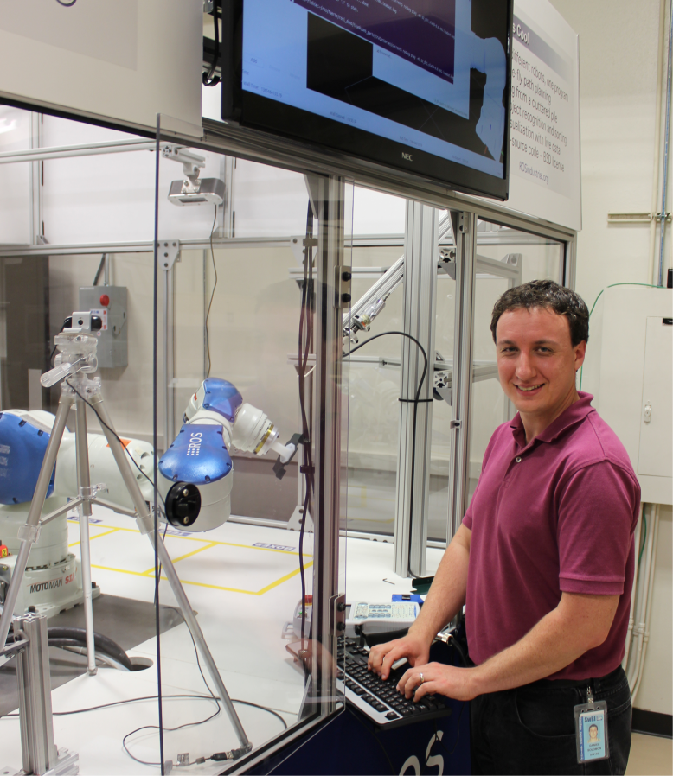
Contact Info.
Daniel Solomon
Research Engineer
Southwest Research Institute
9503 W. Commerce
San Antonio, TX 78227 USA
Phone: 210-522-3147 Email: dsolomon@swri.org
www.ROSindustrial.org

